Slide 1



Tele Communication Project
Data-Driven Approach to Reducing Churn & Improving Retention.
Made By Group 5 [P506]

Slide 2

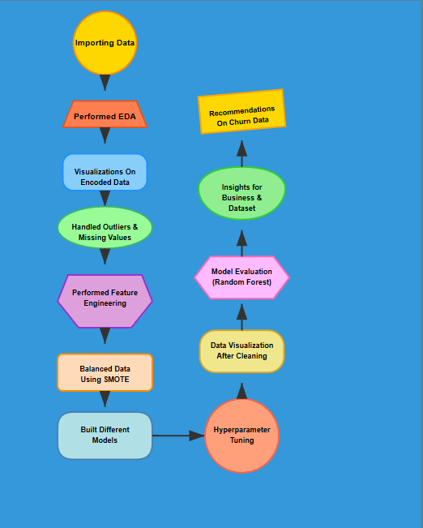
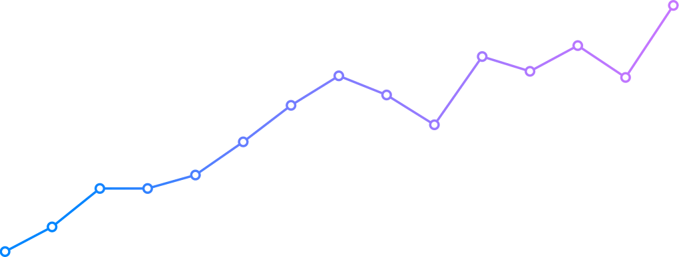
💹 Data Overview
Dataset Summary
Data Preprocessing
Key Metrics
Cleaning steps applied to the
dataset are :
Dataset : 5000 rows, 21 columns
Total Customers: 5,000
Churn Rate: 14.14%
Churned Customers: 707
Customers Who Didn't Churn: 4,293 customers (85.86% of the total)
Total Customers, Churn Rate, Call Usage, Charges.

Slide 3

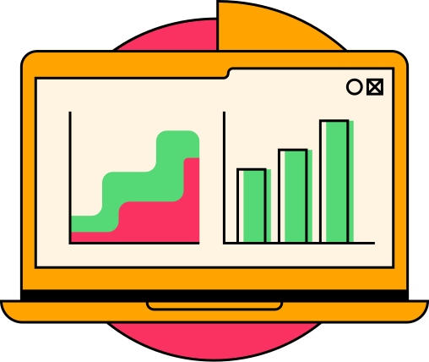
Amazing Fun Facts About Dataset
Amazing Fun Facts About Dataset
Churn Rate: 14.14% (707/5000 customers).
Service Calls: Churned customers made 55% more calls (2.25 vs. 1.46).
Usage Pattern: Churned customers had higher usage across all periods, especially daytime (18% more minutes & charges).
Voicemail Effect: Customers with voicemail plans were less likely to churn (8.29 vs. 4.50 messages).
International Usage: Slightly higher among churned customers, suggesting a minor risk factor.
Account Longevity: Churned customers had longer account tenure (102.33 vs. 99.92 days).
Geographic Diversity: Customers span multiple states and area codes.
Pricing Insight: Charges correlate directly with minutes used across different time periods.

Slide 4

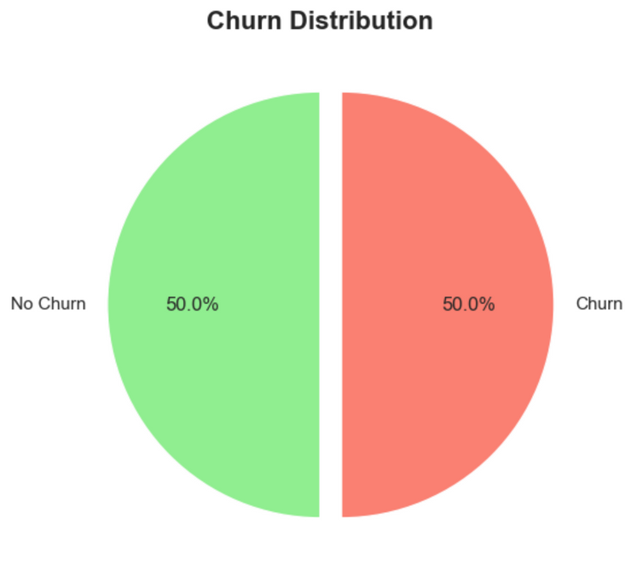
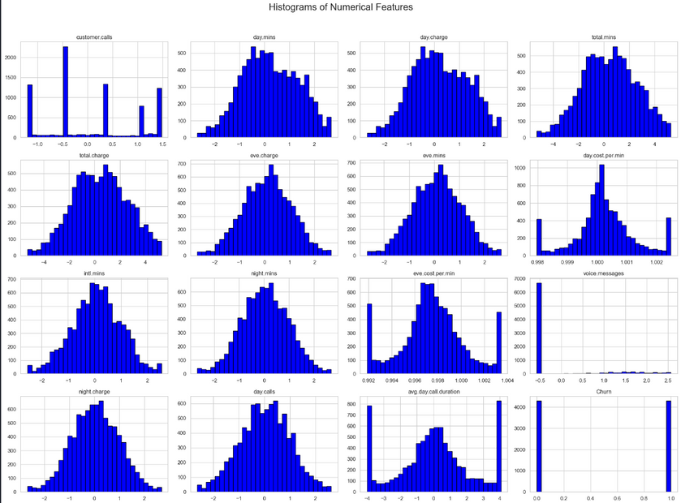
VISUALIZATIONS WITH INSIGHTS
The perfectly balanced 50/50 churn distribution indicates this is likely a resampled or synthetic dataset created for balanced model training, unlike the original imbalanced dataset with only 14.1% churn rate.
Customer call distribution shows distinct peaks at specific values,
while most usage metrics (minutes, charges) follow normal-like distributions.

Slide 5

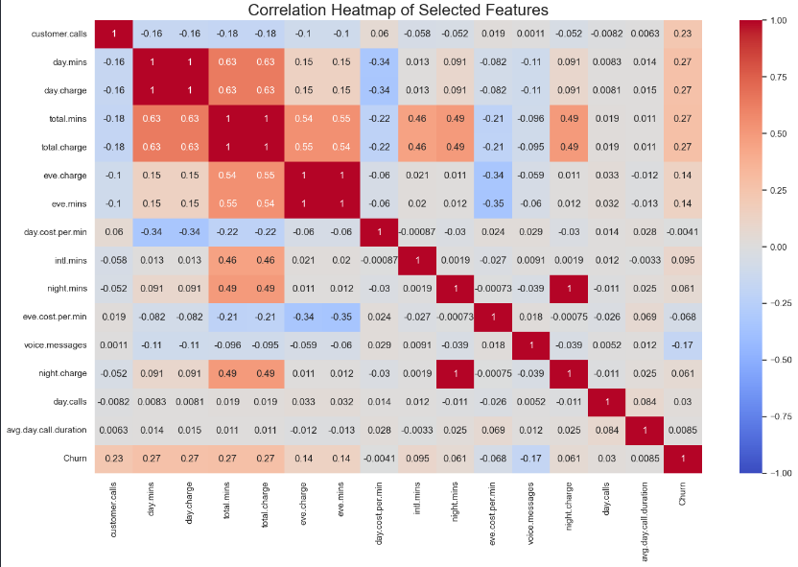
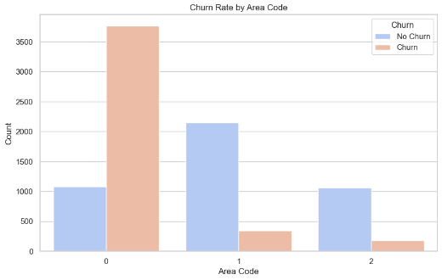
Day minutes and day charge show perfect correlation (1.0), and all time-based features (day/evening/night) show moderate positive correlations with each other.
Area code 0 has alarmingly high churn rates,
while area codes 1 and 2 maintain much healthier customer retention.

Slide 6

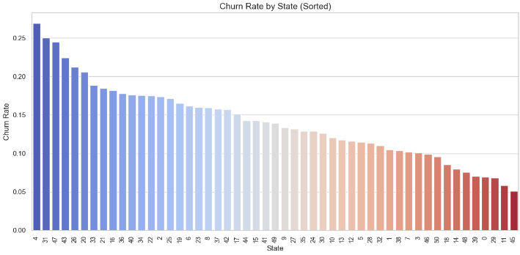
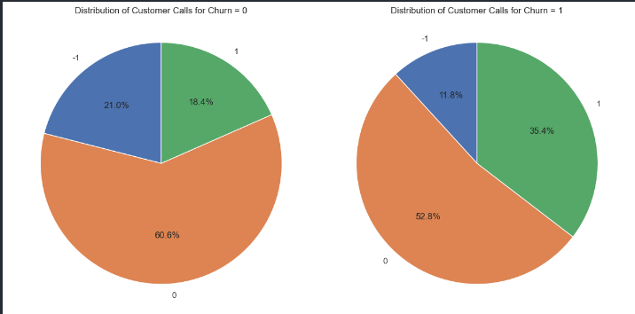
Customer call distributions show churned customers have significantly higher call type 1 (35.4% vs 18.4%) and lower call type 0 (52.8% vs 60.6%) compared to non-churned customers.
States labeled 4, 1, and 37 have the highest churn rates (>0.22), while states 15 and 16 have the lowest (<0.06).

Slide 7
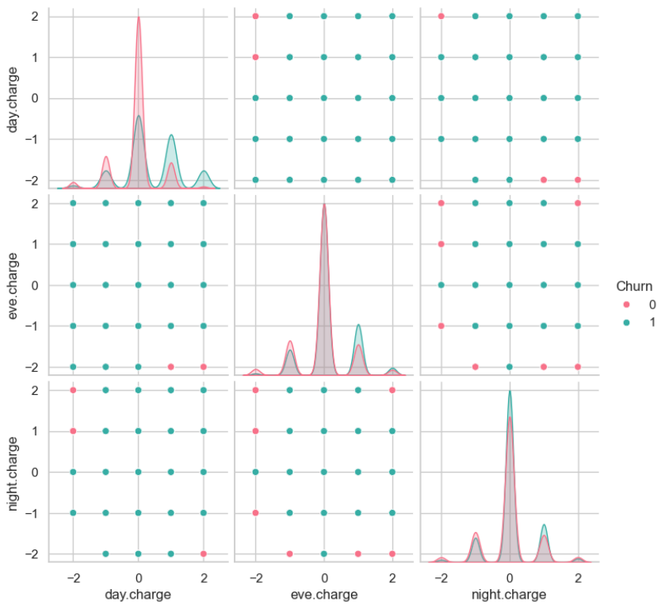
PAIRPLOT FOR MOST IMPORTANT FEATURES
Pairwise relationships between day, evening, and night charges show similar distributions for both churned and non-churned customers, with prominent peaks at specific charge values and no clear separation between churn groups.

Slide 8

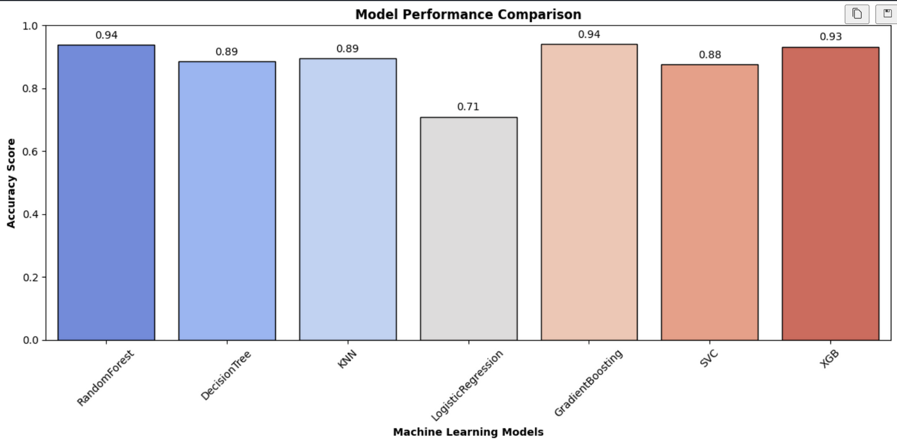
RandomForest and GradientBoosting lead with 0.94 accuracy scores, while LogisticRegression significantly underperforms at 0.71. Other Models too had a decent accuracy.

Slide 9

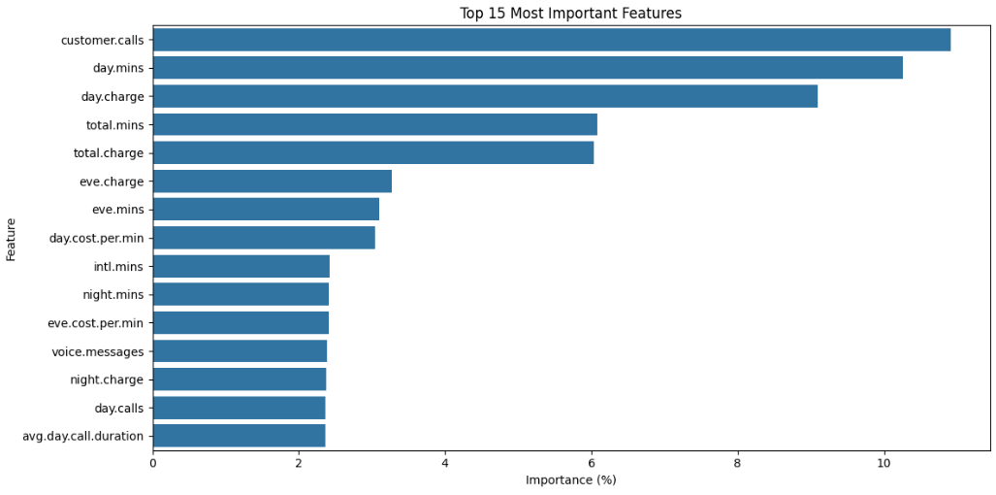
Customer service interaction (customer calls) and daytime usage metrics (day.mins and day.charge) are significantly more important predictors of churn than evening/night usage or call frequency metrics.
IMPORTANT
FEATURES
FOR
MODEL
BUILDING
📚

Slide 10

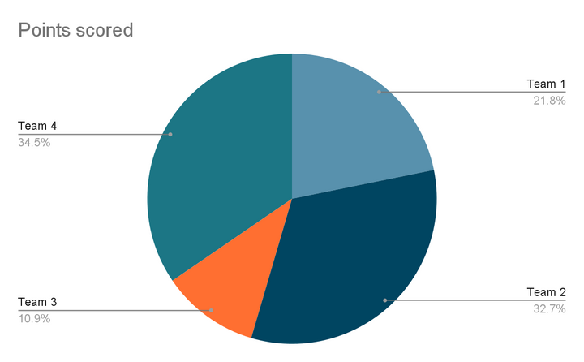

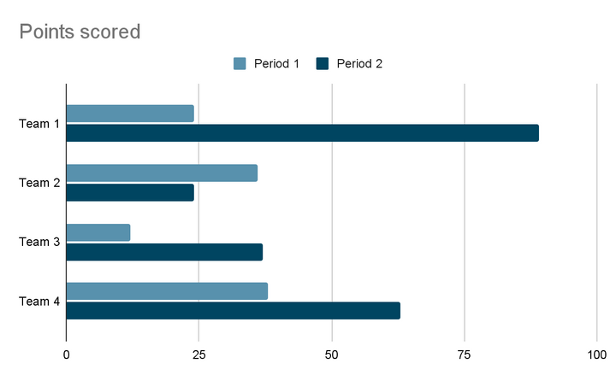
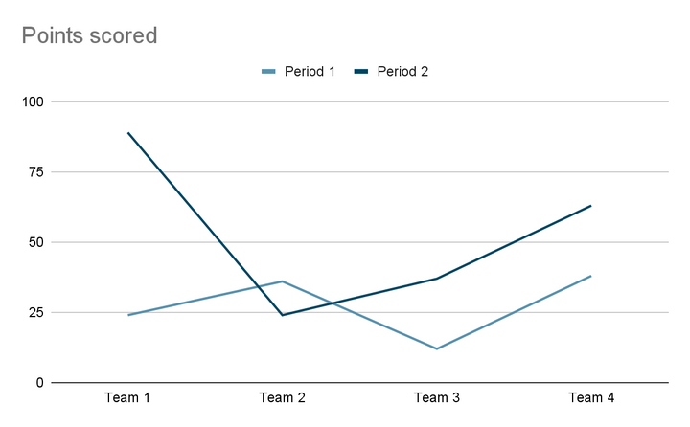
Insights For The Dataset

Slide 11

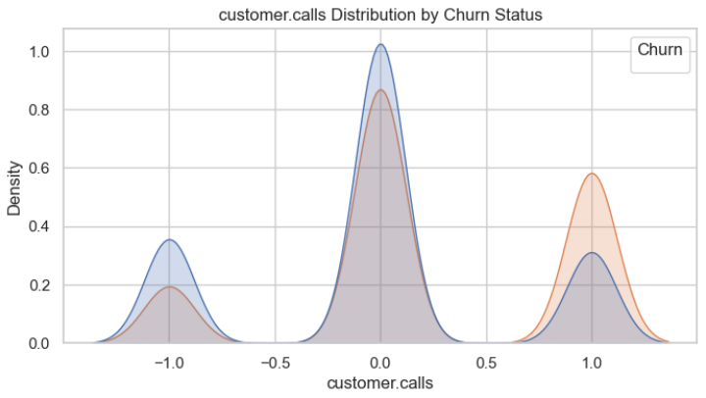
Business Insights
Churn Risk Factors: High service calls (up to 9) indicate customer dissatisfaction
Customer Segmentation: Heavy users (>350 daily minutes) require tailored plans
Pricing Strategy: Day and international charges strongly correlate with churn
Service Opportunities: Similar night/evening usage (~200 mins) suggests potential for specialized plans
Data Quality Issues: Address missing values in charge/minutes columns to improve model accuracy
Key General Insights
Frequent customer service calls (>3-4) strongly predict churn
High-usage customers need targeted retention strategies
Day/international call charges correlate with churn
Premium service users show lower churn rates
Implement state-specific strategies for high-churn regions
Monitor high-spending customers for proactive retention
Create customized plans based on usage patterns
Improve customer support quality for repeat callers

Slide 12

What Next ?
Personalized Experience
AI Recommendations
Journey Mapping
Personalized Channels
05
5. Strategic Partnerships
Complementary Providers
Co-Branding
Integration
01
04
4. Digital Transformation
Omni-channel
Self-Service
Predictive Analytics
2. Retention Pricing
Value-Based Pricing
Loyalty Programs
Tiered Pricing
02
03
3. Product Innovation
Feedback Loops
Feature Prioritization
Innovation Teams

Slide 13

CONCLUSION
The analysis highlights the importance of proactive customer retention strategies, personalized service offerings, and geographic targeting to address high churn rates. Implementing these insights can help reduce customer churn, improve operational efficiency, and drive business growth. The use of predictive analytics and feedback mechanisms will be essential in continuously refining these strategies to meet evolving customer needs.
Overall, the study provides a comprehensive framework for telecom companies to enhance customer retention and improve their competitive edge in the market.
In conclusion, the analysis not only informed but also optimized decision-making by providing a robust framework for addressing customer churn. It enabled leaders to act with greater confidence, aligning actions with data-backed insights to achieve better business outcomes.

Slide 14


CHALLENGES
FACED WHILE
PROJECT-MAKING
Faced issues with Coding for Graphs.
Faced Issues while Deploying The App on Local Host Server.
Managing Resources was a problem sometimes.
= Otherwise, No major issues faced while Project-Making.

Slide 15
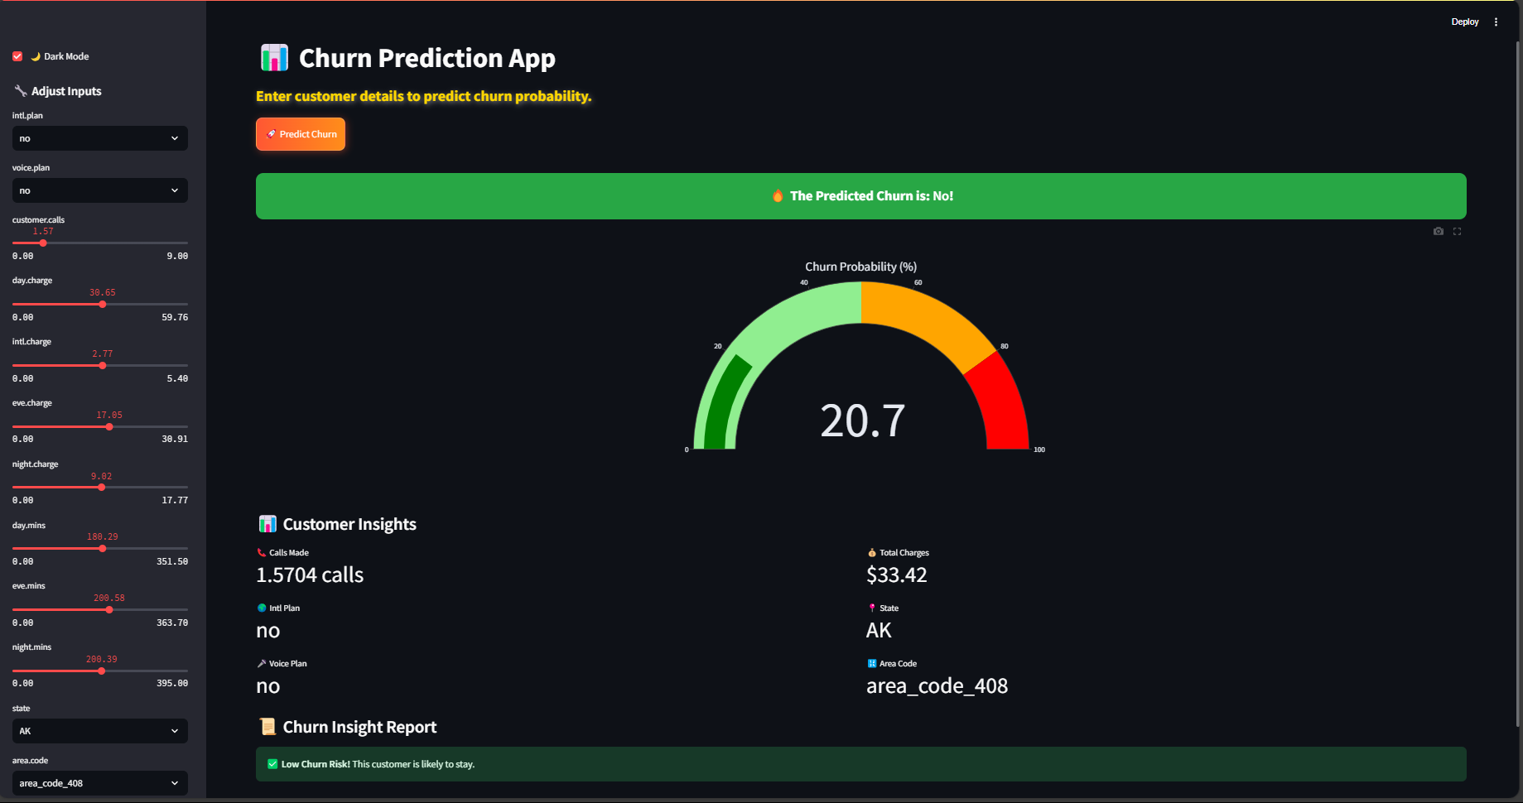
Deployment Page

Slide 16


